Slide 1

Vist this place
Bath

Slide 2
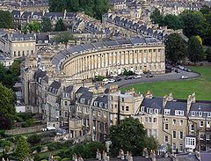
History
The city was first established as a spa resort with the Latin name, Aquae Sulis ("the waters of Sulis") by the Romans in AD 43 although verbal tradition suggests that Bath was known before then.

Slide 3
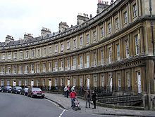
They built baths and a temple on the surrounding hills of Bath in the valley of the River Avon around hot springs, which are the only ones naturally occurring in the United Kingdom.

Slide 4
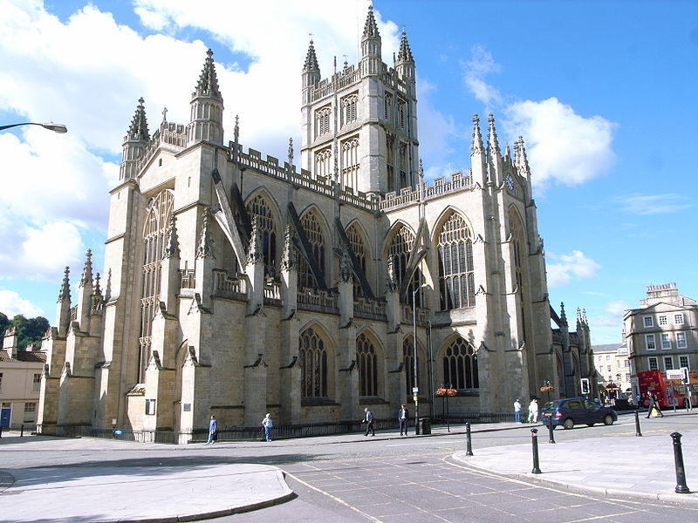
    ] Edgar was crowned king of England at Bath Abbey in 973. Much later, it became popular as a spa resort during the Georgian era, which led to a major expansion that left a heritage of exemplary Georgiarchitecture
    crafted from Bath Stone.

Slide 5
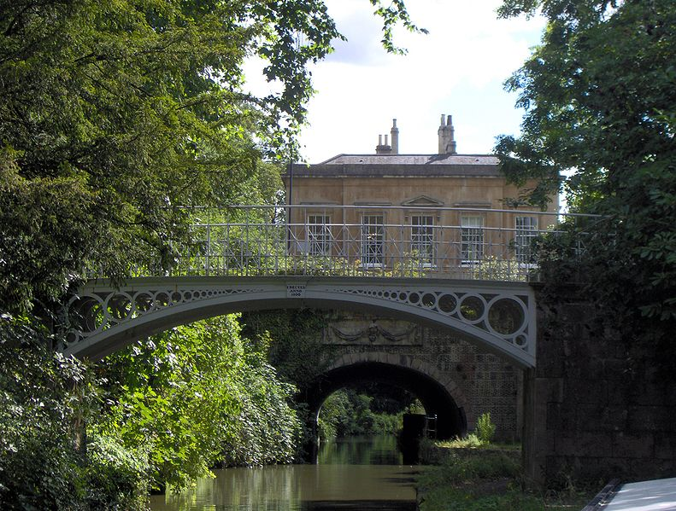
Bautifull town
King William Rufus granted the city to a royal physician, John of Tours, who became Bishop of Wells and Abbot of Bath in 1088.It was papal policy for bishops to move to more urban seats, and he translated his own from Wells to Bath.He planned and began a much larger church as his cathedral, to which was attached a priory, with the bishop's palace beside it.^{[20]}

Slide 6
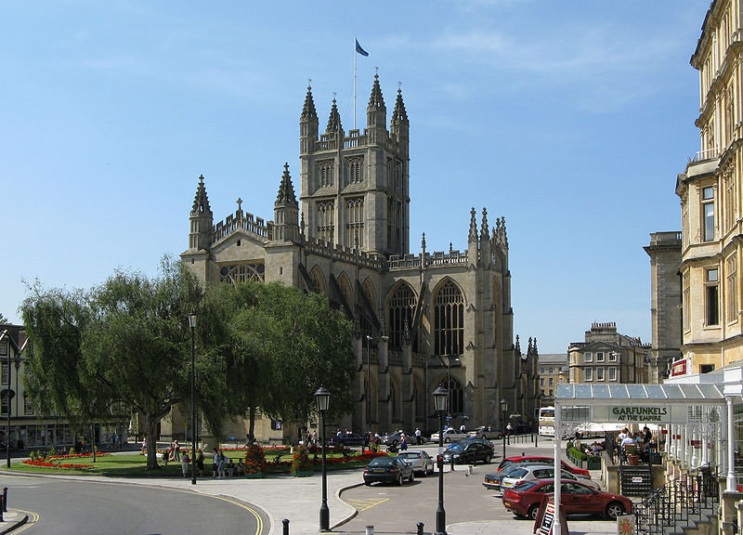
New baths were built around the three springs. However, later bishops returned the episcopal seat to Wells, while retaining the name of Bath in their title as the Bishop of Bath and Wells.
By the 15th century, Bath's abbey church was badly dilapidated and in need of repairs.^{[23]} Oliver King, Bishop of Bath and Wells, decided in 1500 to rebuild it on a smaller scale. The new church was completed just a few years before Bath Priory was dissolved in 1539 by Henry VIII.^{[24}

Slide 7
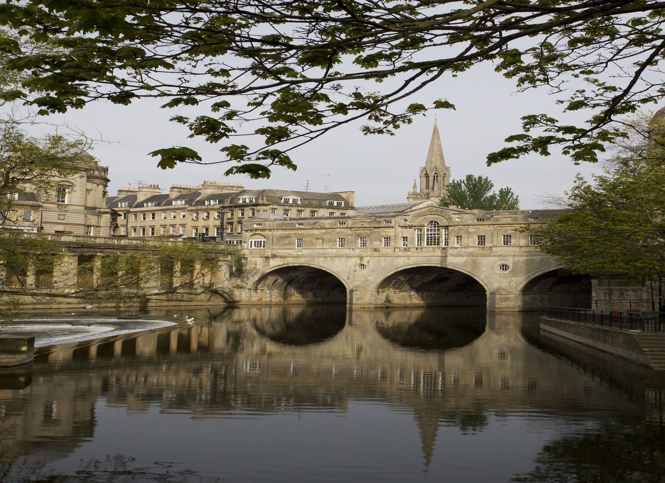
] The abbey church was allowed to become derelict before being restored as the city's parish church in the Elizabethan period, when the city experienced a revival as a spa. The baths were improved and the city began to attract the aristocracy. Bath was granted city status by Royal Charter by Queen Elizabeth I in 1590.

Slide 8
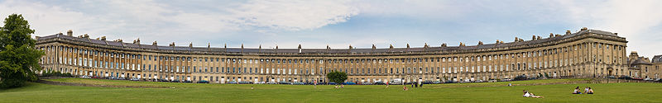
You must go to the bath bcose it is very prety town

Slide 9
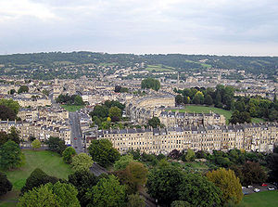

Slide 10
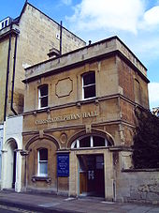
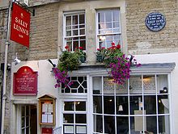
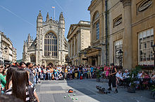
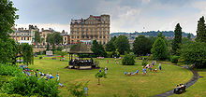
Look for this! This isphoto for Bath .

